Slide 1


CSE211
Computer Organization and Design
Lecture : 3
Tutorial: 1
Practical: 0
Credit: 4
1

Slide 2
Overview
2
Register Transfer Language
Register Transfer
Bus and Memory Transfers
Logic Micro-operations
Shift Micro-operations
Arithmetic Logic Shift Unit
CSE 211

Slide 3
How much storage capacity does each stage in a shift register represent?
One bit
Two bits
Four bits
Eight bits

Slide 4
The bus used to connect the monitor to the CPU is
PCI bus
SCSI bus
Memory bus
Rambus

Slide 5
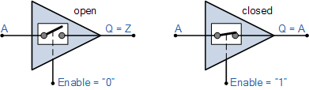
Tri-state Buffer Switch Equivalent
When activated into its third state it disables or turns “OFF” its output producing an open circuit condition that is neither at a logic “HIGH” or “LOW”, but instead gives an output state of very high impedance, High-Z, or more commonly Hi-Z. Then this type of device has two logic state inputs, “0” or a “1” but can produce three different output states, “0”, “1” or ” Hi-Z ” which is why it is called a “Tri” or “3-state” device.
Note that this third state is NOT equal to a logic level “0” or “1”, but is an high impedance state in which the buffers output is electrically disconnected from the rest of the circuit. As a result, no current is drawn from the supply.

Slide 6
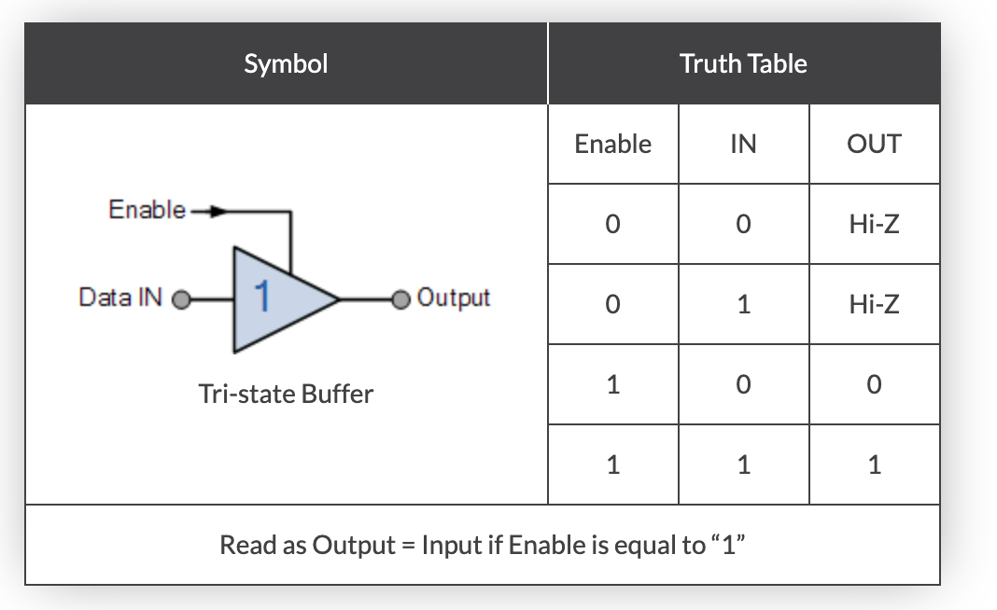

Slide 7
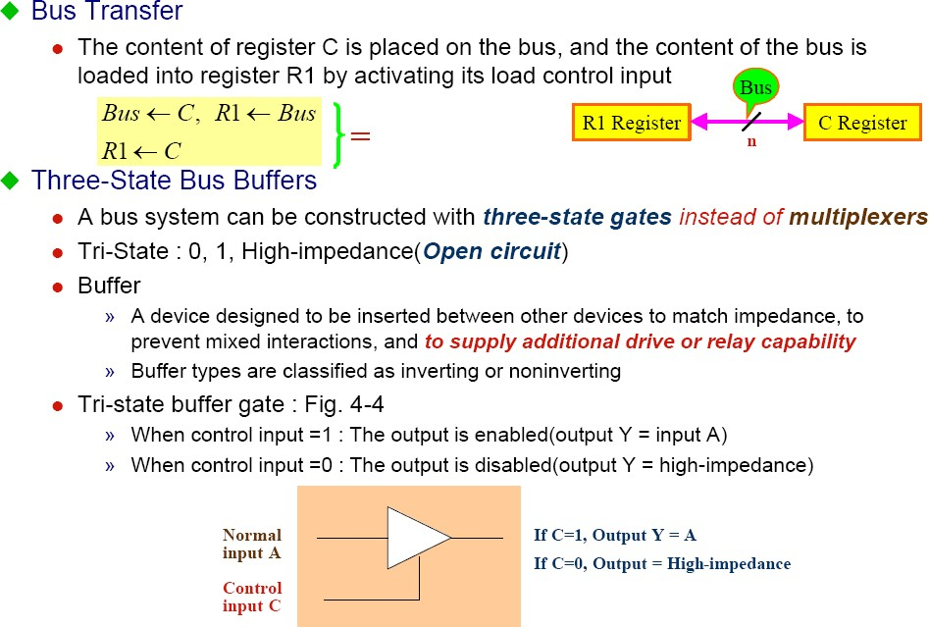
Connecting Registers - Bus Transfer
7

Slide 8
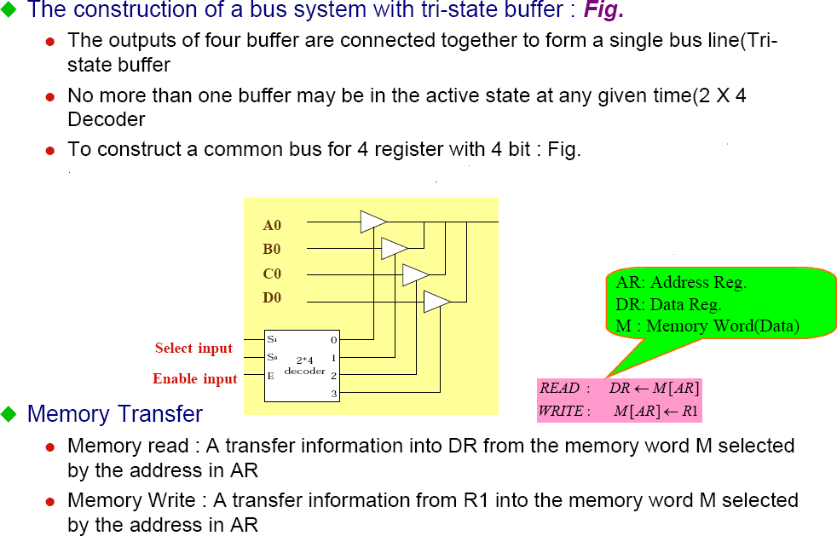
Connecting Registers - Bus Transfer
8

Slide 9
Memory Transfer
9
Memory is usually accessed in computer systems by putting the desired address in a special register, the Memory Address Register (MAR, or AR)
M
Memory unit
Read
AR
Write
Data out Data in

Slide 10
Memory Read
10
To read a value from a location in memory and load it into a register, the register transfer language notation looks like this:
R1 ← M[MAR]
This causes the following to occur
The contents of the MAR get sent to the memory address lines
A Read (= 1) gets sent to the memory unit
The contents of the specified address are put on the memory’s output data lines
These get sent over the bus to be loaded into register R1

Slide 11
Memory Write
11
To write a value from a register to a location in memory looks like this in register transfer language:
M[MAR] ← R1
This causes the following to occur
The contents of the MAR get sent to the memory address lines
A Write (= 1) gets sent to the memory unit
The values in register R1 get sent over the bus to the data input lines of the memory
The values get loaded into the specified address in the memory

Slide 12
12
SUMMARY OF R. TRANSFER MICROOPERATIONS
A ← B 1.Transfer content of reg. B into reg. A A ← constant 3.Transfer a binary constant into reg. A ABUS ← R1, R2 ← ABUS 4.Transfer content of R1 into bus A and, at the same time transfer content of bus A into R2 AR 5.Address register DR 6.Data register M[R] 7.Memory word specified by reg. R M 8.Equivalent to M[AR] DR ← M 9.Memory read operation: transfers content of memory word specified by AR into DR M ← DR 10.Memory write operation: transfers content of DR into memory word specified by AR
,

Slide 13
MICROOPERATIONS
13
Computer system microoperations are of four types:
Register transfer microoperations
Arithmetic microoperations
Logic microoperations
Shift microoperations

Slide 14
Arithmetic MICROOPERATIONS
14
•
The basic arithmetic microoperations are
–
–
–
–
Addition Subtraction Increment Decrement
•
The additional arithmetic microoperations are
–
–
–
–
Add with carry Subtract with borrow Transfer/Load
etc. …
Summary of Typical Arithmetic Micro-Operations
R3 ← R1 + R2 R3 ← R1 - R2 R2 ← R2’
R2 ← R2’+ 1
R3 ← R1 + R2’+ 1 R1 ← R1 + 1
R1 ← R1 - 1
Contents of R1 plus R2 transferred to R3 Contents of R1 minus R2 transferred to R3 Complement the contents of R2
2's complement the contents of R2 (negate) subtraction
Increment Decrement

Slide 15
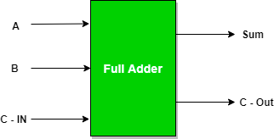
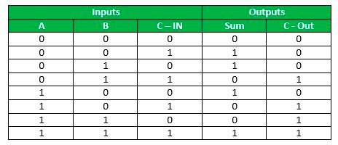
Full Adder
is the adder which
adds three inputs and produces two outputs. The first two inputs are A and B and the third input is an input carry as C-IN. The output carry is designated as C-OUT and the normal output is designated as S which is SUM.

Slide 16
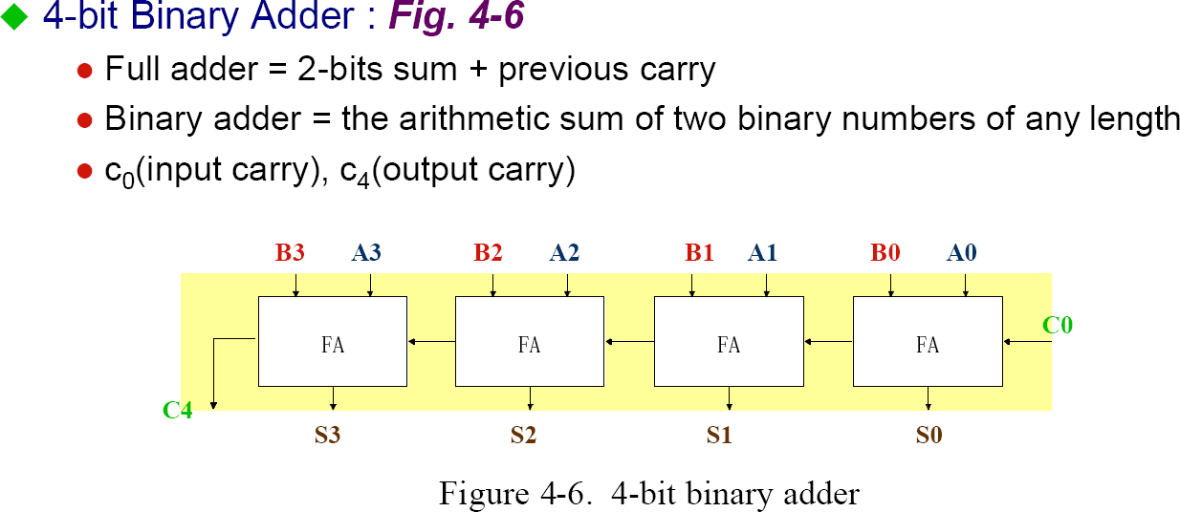
Binary Adder
16

Slide 17


Binary Adder-Subtractor
17
Binary Adder-Subtractor
B3 A3
B2 A2
B1 A1
B0 A0
M
FA
C3
FA
C2
FA
C1
FA
C0
C4
S3 S2
S1
S0
Mode input M controls the operation
M=0 ---- adder
M=1 ---- subtractor

Slide 18


Binary Incrementer
18
Binary Incrementer
A3
A2
A1
A0
1
x
HA
y
x
HA
y
x y
HA
x y
HA
C
S
C
S
C
S
C
S
C4 S3
S2
S1
S0

Slide 19
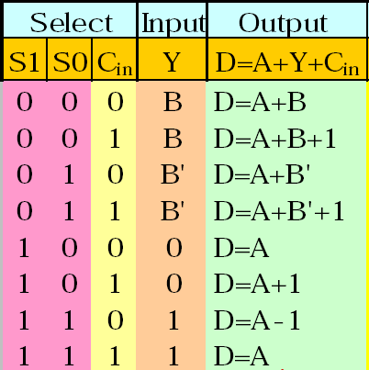





Arithmetic Circuits
19
Cin
S1 S0
A0
X0 C0
FA
Y0 C1
S1 S0
0
D0
B0
4x1
1
2 MUX
3
A1
X1 C1
FA
Y1 C2
S1 S0
0
D1
B1
4x1
1
2 MUX
3
A2
X2 C2
FA
Y2 C3
S1 S0
0
D2
B2
4x1
1
2 MUX
3
A3
X3 C3
FA
Y3 C4
S1 S0
0
D3
B3
4x1
1
2 MUX
3
Cout
0 1

